Slide 1
Plots and Graphics

Slide 2
Basic Task: Plot the function sin(x) between 0≤x≤4π
Create an x-array of 100 samples between 0 and 4π.
Calculate sin(.) of the x-array
Plot the y-array
>>x=linspace(0,4*pi,100);
>>y=sin(x);
>>plot(y)

Slide 3
Plot the function e^{-x/3}sin(x) between 0≤x≤4π
Create an x-array of 100 samples between 0 and 4π.
Calculate sin(.) of the x-array
Calculate e^{-x/3} of the x-array
Multiply the arrays y and y1
>>x=linspace(0,4*pi,100);
>>y=sin(x);
>>y1=exp(-x/3);
>>y2=y*y1;

Slide 4
Plot the function e^{-x/3}sin(x) between 0≤x≤4π
Multiply the arrays y and y1 correctly
Plot the y2-array
>>y2=y.*y1;
>>plot(y2)

Slide 5
Display Facilities
plot(.)
stem(.)
Example:
>>x=linspace(0,4*pi,100);
>>y=sin(x);
>>plot(y)
>>plot(x,y)
Example:
>>stem(y)
>>stem(x,y)

Slide 6
Display Facilities
title(.)
xlabel(.)
ylabel(.)
>>title(‘This is the sinus function’)
>>xlabel(‘x (secs)’)
>>ylabel(‘sin(x)’)

Slide 7
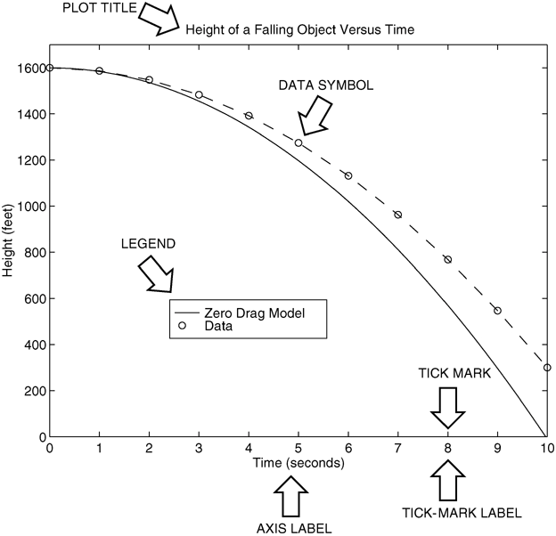
Nomenclature for a typical xy plot.

Slide 8
Example: The following MATLAB session plots
y = 0.4 √1.8x for 0 ≤ x ≤ 52, where y represents the height of a rocket after launch, in miles, and x is the horizontal (downrange) distance in miles.
>>x = 0:0.1:52;
>>y = 0.4*sqrt(1.8*x);
>>plot(x,y)
>>xlabel(’Distance (miles)’)
>>ylabel(’Height (miles)’)
>>title(‘Rocket Height as a Function of Downrange Distance’)
The resulting plot is shown on the next slide.

Slide 9
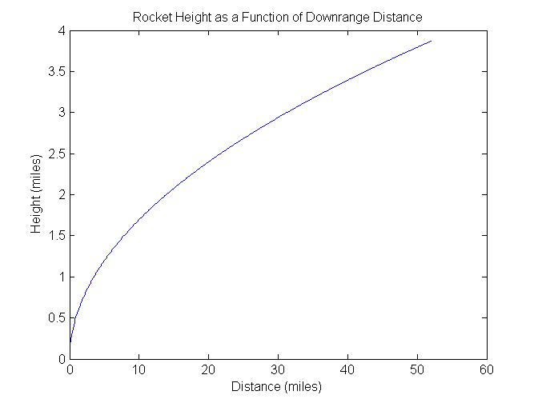
The auto scaling feature in MATLAB selects tick-mark spacing.

Slide 10
The plot will appear in the Figure window. You can obtain a hard copy of the plot in several ways:
1. Use the menu system. Select Print on the File menu in the Figure window. Answer OK when you are prompted to continue the printing process.
2. Type print at the command line. This command sends the current plot directly to the printer.
3. Save the plot to a file to be printed later or imported into another application such as a word processor. You need to know something about graphics file formats to use this file properly. See the subsection Exporting Figures

Slide 11
When you have finished with the plot, close the figure window by selecting Close from the File menu in the figure window.
Note that using the Alt-Tab key combination in Windows-based systems will return you to the Command window without closing the figure window.
If you do not close the window, it will not reappear when a new plot command is executed. However, the figure will still be updated.

Slide 12
Requirements for a Correct Plot
The following list describes the essential features of any plot:
1. Each axis must be labeled with the name of the quantity being plotted and its units! If two or more quantities having different units are plotted (such as when plotting both speed and distance versus time), indicate the units in the axis label if there is room, or in the legend or labels for each curve.
2. Each axis should have regularly spaced tick marks at convenient intervals—not too sparse, but not too dense—with a spacing that is easy to interpret and interpolate. For example, use 0.1, 0.2, and so on, rather than 0.13, 0.26, and so on.
(continued …)

Slide 13
Requirements for a Correct Plot (continued)
3. If you are plotting more than one curve or data set, label each on its plot or use a legend to distinguish them.
4. If you are preparing multiple plots of a similar type or if the axes’ labels cannot convey enough information, use a title.
5. If you are plotting measured data, plot each data point with a symbol such as a circle, square, or cross (use the same symbol for every point in the same data set). If there are many data points, plot them using the dot symbol.
(continued …)

Slide 14
6. Sometimes data symbols are connected by lines to help the viewer visualize the data, especially if there are few data points. However, connecting the data points, especially with a solid line, might be interpreted to imply knowledge of what occurs between the data points. Thus you should be careful to prevent such misinterpretation.
7. If you are plotting points generated by evaluating a function (as opposed to measured data), do not use a symbol to plot the points. Instead, be sure to generate many points, and connect the points with solid lines.

Slide 15
The grid and axis Commands
The grid command displays gridlines at the tick marks corresponding to the tick labels. Type grid on to add gridlines; type grid off to stop plotting gridlines. When used by itself, grid toggles this feature on or off, but you might want to use grid on and grid off to be sure.
You can use the axis command to override the MATLAB selections for the axis limits. The basic syntax is axis([xmin xmax ymin ymax]). This command sets the scaling for the x- and y-axes to the minimum and maximum values indicated. Note that, unlike an array, this command does not use commas to separate the values.
More? See page 222.

Slide 16
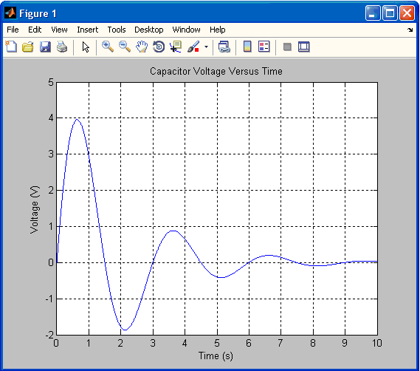
Example of a Figure window.

Slide 17
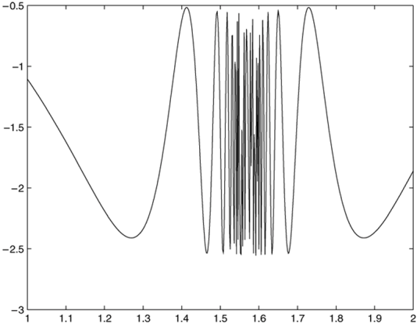
The fplot command is a “smart” plotting function.

Slide 18
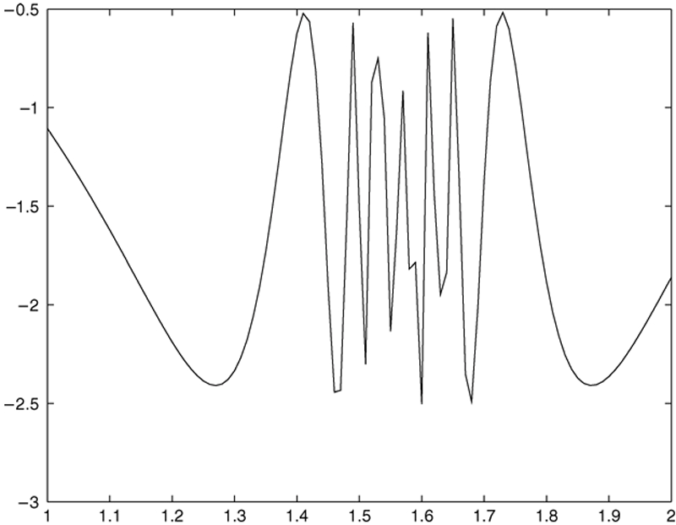
The function in generated with the plot command, which gives more control than the fplot command.

Slide 19
Plotting Polynomials with the polyval Function.
To plot the polynomial 3x⁵ + 2x⁴ – 100x³ + 2x² – 7x + 90 over the range –6 ≤ x ≤ 6 with a spacing of 0.01, you type
>>x = -6:0.01:6;
>>p = [3,2,-100,2,-7,90];
>>plot(x,polyval(p,x)),xlabel(’x’), ...
ylabel(’p’)

Slide 20
Saving Figures
To save a figure that can be opened in subsequent MATLAB sessions, save it in a figure file with the .fig file name extension.
To do this, select Save from the Figure window File menu or click the Save button (the disk icon) on the toolbar.
If this is the first time you are saving the file, the Save As dialog box appears. Make sure that the type is MATLAB Figure (*.fig). Specify the name you want assigned to the figure file. Click OK.

Slide 21
Exporting Figures
To save the figure in a format that can be used by another application, such as the standard graphics file formats TIFF or EPS, perform these steps.
1. Select Export Setup from the File menu. This dialog lets you specify options for the output file, such as the figure size, fonts, line size and style, and output format.
2. Select Export from the Export Setup dialog. A standard Save As dialog appears.
3. Select the format from the list of formats in the Save As type menu. This selects the format of the exported file and adds the standard file name extension given to files of that type.
4. Enter the name you want to give the file, less the extension. Then click Save.
More? See pages 225-226.

Slide 22
On Windows systems, you can also copy a figure to the clipboard and then paste it into another application:
1. Select Copy Options from the Edit menu. The Copying Options page of the Preferences dialog box appears.
2. Complete the fields on the Copying Options page and click OK.
3. Select Copy Figure from the Edit menu.

Slide 23
Subplots
You can use the subplot command to obtain several smaller “subplots” in the same figure. The syntax is subplot(m,n,p). This command divides the Figure window into an array of rectangular panes with m rows and n columns. The variable p tells MATLAB to place the output of the plot command following the subplot command into the pth pane.
For example, subplot(3,2,5) creates an array of six panes, three panes deep and two panes across, and directs the next plot to appear in the fifth pane (in the bottom-left corner).

Slide 24
The following script file created Figure 5.2–1, which shows the plots of the functions y = e^{−1.2x} sin(10x + 5) for 0 ≤ x ≤ 5 and y = |x³ − 100| for −6 ≤ x ≤ 6.
x = 0:0.01:5;
y = exp(-1.2*x).*sin(10*x+5);
subplot(1,2,1)
plot(x,y),axis([0 5 -1 1])
x = -6:0.01:6;
y = abs(x.^3-100);
subplot(1,2,2)
plot(x,y),axis([-6 6 0 350])
The figure is shown on the next slide.

Slide 25
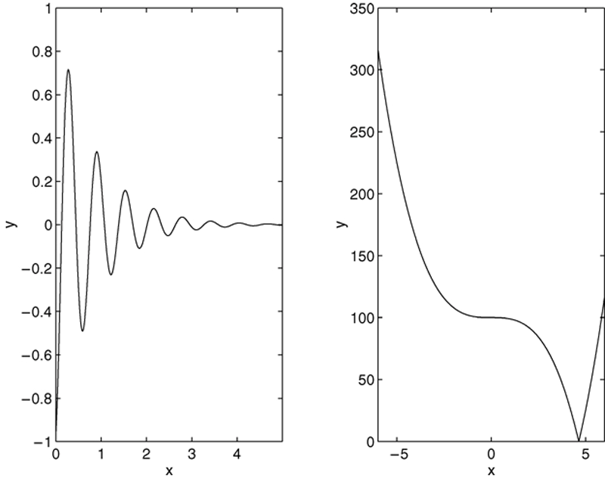
Application of the subplot command

Slide 26
Data Markers and Line Types
To plot y versus x with a solid line and u versus v with a dashed line, type plot(x,y,u,v,’--’), where the symbols ’--’ represent a dashed line.
To plot y versus x with asterisks (*) connected with a dotted line, you must plot the data twice by typing plot(x,y,’*’,x,y,’:’).

Slide 27
To plot y versus x with green asterisks (∗) connected with a red dashed line, you must plot the data twice by typing plot(x,y,’g*’,x,y,’r--’).

Slide 28
Specifiers for data markers, line types, and colors.
Data markers†
Dot (.)
Asterisk (*)
Cross (×)
Circle ( )
Plus sign (+)
Square ( )
Diamond ( )
Five-pointed star (w)
.
*
×
+
s
d
p
Line types
Solid line
Dashed line
Dash-dotted line
Dotted line
––
– –
– .
….
Colors
Black
Blue
Cyan
Green
Magenta
Red
White
Yellow
k
b
c
g
m
r
w
y
†Other data markers are available.
Search for “markers” in MATLAB help.

Slide 29
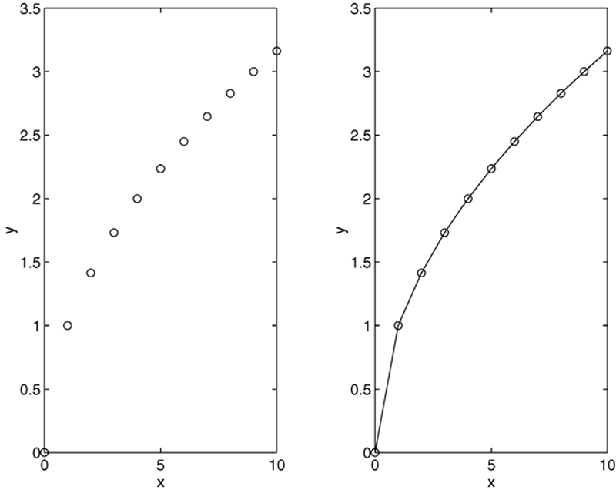
Use of data markers..

Slide 30
Labeling Curves and Data
The legend command automatically obtains from the plot the line type used for each data set and displays a sample of this line type in the legend box next to the string you selected. The following script file produced the plot in Figure 5.2–3 (see next slide).
x = 0:0.01:2;
y = sinh(x);
z = tanh(x);
plot(x,y,x,z,’--’),xlabel(’x’), ...
ylabel(’Hyperbolic Sine and Tangent’), ...
legend(’sinh(x)’,’tanh(x)’)

Slide 31
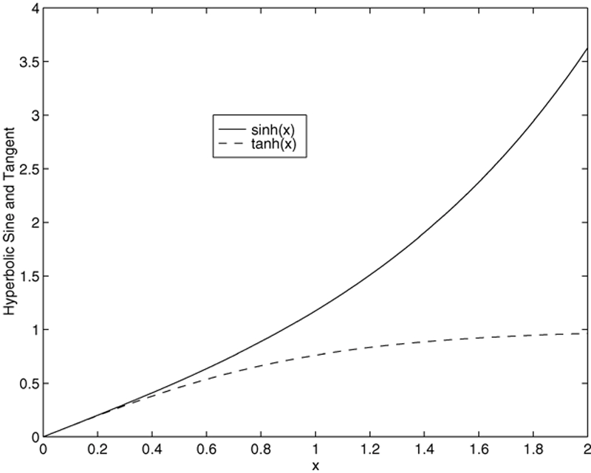
Application of the legend command.

Slide 32
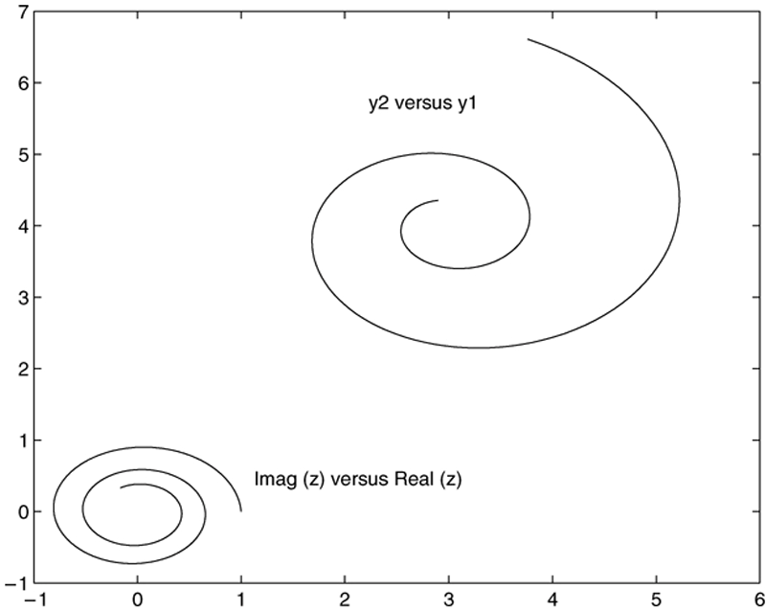
Application of the hold command.

Slide 33
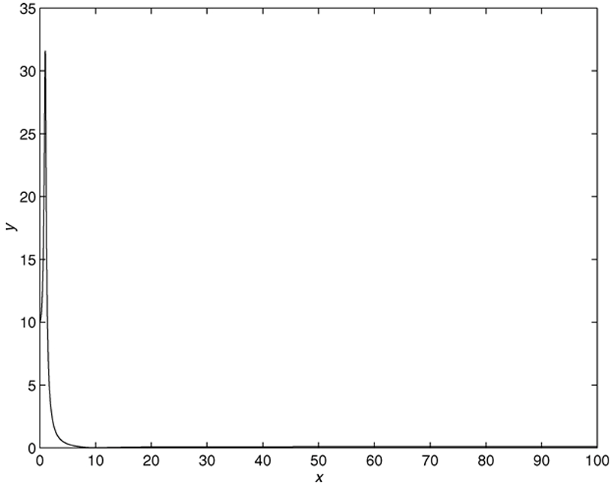
Why use log scales? Rectilinear scales cannot properly display variations over wide ranges.

Slide 34
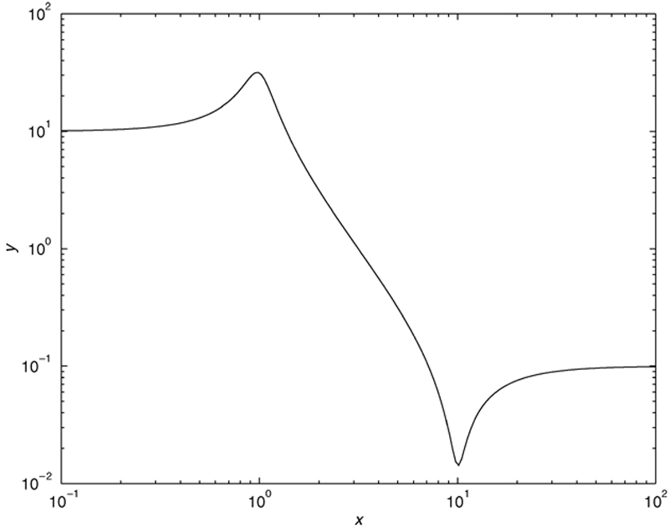
A log-log plot can display wide variations in data values.

Slide 35
Logarithmic Plots
It is important to remember the following points when using log scales:
1. You cannot plot negative numbers on a log scale, because the logarithm of a negative number is not defined as a real number.
2. You cannot plot the number 0 on a log scale, because log₁₀ 0 = ln 0 = −∞. You must choose an appropriately small number as the lower limit on the plot.
(continued…)

Slide 36
Logarithmic Plots (continued)
3. The tick-mark labels on a log scale are the actual values being plotted; they are not the logarithms of the numbers. For example, the range of x values in the plot in Figure 5.3–2 is from 10⁻¹ = 0.1 to 10² = 100.
4. Gridlines and tick marks within a decade are unevenly spaced. If 8 gridlines or tick marks occur within the decade, they correspond to values equal to 2, 3, 4, . . . , 8, 9 times the value represented by the first gridline or tick mark of the decade.
(continued…)

Slide 37
Logarithmic Plots (continued)
Equal distances on a log scale correspond to multiplication by the same constant (as opposed to addition of the same constant on a rectilinear scale).
For example, all numbers that differ by a factor of 10 are separated by the same distance on a log scale. That is, the distance between 0.3 and 3 is the same as the distance between 30 and 300. This separation is referred to as a decade or cycle.
The plot shown in Figure 5.3–2 covers three decades in x (from 0.1 to 100) and four decades in y and is thus called a four-by-three-cycle plot.

Slide 38
MATLAB has three commands for generating plots having log scales. The appropriate command depends on which axis must have a log scale.
Use the loglog(x,y) command to have both scales logarithmic.
2. Use the semilogx(x,y) command to have the x scale logarithmic and the y scale rectilinear.
3. Use the semilogy(x,y) command to have the y scale logarithmic and the x scale rectilinear.

Slide 39
Specialized plot commands.
Command
bar(x,y)
plotyy(x1,y1,x2,y2)
polar(theta,r,’type’)
stairs(x,y)
stem(x,y)
Description
Creates a bar chart of y versus x.
Produces a plot with two y-axes, y1 on the left and y2 on the right.
Produces a polar plot from the polar coordinates theta and r, using the line type, data marker, and colors specified in the string type.
Produces a stairs plot of y versus x.
Produces a stem plot of y versus x.

Slide 40
Exponential and Power Functions Plotted on Log Scales

Slide 41
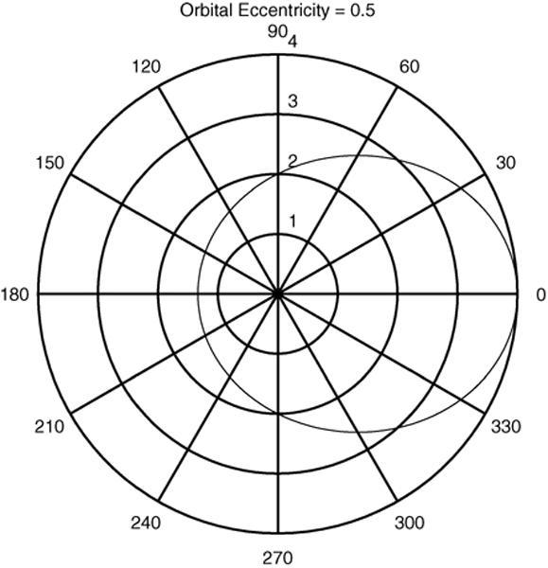
A polar plot showing an orbit having an eccentricity of 0.5.

Slide 42
Error Plots
The code is on page 238.

Slide 43
Interactive Plotting in MATLAB
This interface can be advantageous in situations where:
• You need to create a large number of different types of plots,
• You must construct plots involving many data sets,
• You want to add annotations such as rectangles and ellipses, or
• You want to change plot characteristics such as tick spacing, fonts, bolding, italics, and colors.

Slide 44
The interactive plotting environment in MATLAB is a set of tools for:
• Creating different types of graphs,
• Selecting variables to plot directly from the Workspace Browser,
• Creating and editing subplots,
• Adding annotations such as lines, arrows, text, rectangles, and ellipses, and
• Editing properties of graphics objects, such as their color, line weight, and font.

Slide 45

The Figure toolbar displayed.

Slide 46
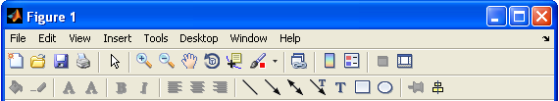
The Figure and Plot Edit toolbars displayed.

Slide 47
The Plot Tools interface includes the following three panels associated with a given figure.
• The Figure Palette: Use this to create and arrange subplots, to view and plot workspace variables, and to add annotations.
• The Plot Browser: Use this to select and control the visibility of the axes or graphics objects plotted in the figure, and to add data for plotting.
• The Property Editor: Use this to set basic properties of the selected object and to obtain access to all properties through the Property Inspector.

Slide 48
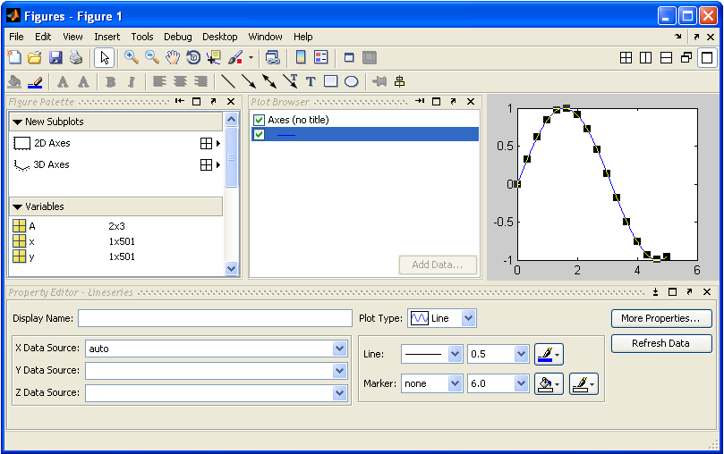
The Figure window with the Plot Tools activated.

Slide 49
Three-Dimensional Line Plots:
The following program uses the plot3 function to generate the spiral curve
>>t = 0:pi/50:10*pi;
>>plot3(exp(-0.05*t).*sin(t),...
exp(-0.05*t).*cos(t),t),...
xlabel(’x’),ylabel(’y’),zlabel(’z’),grid

Slide 50
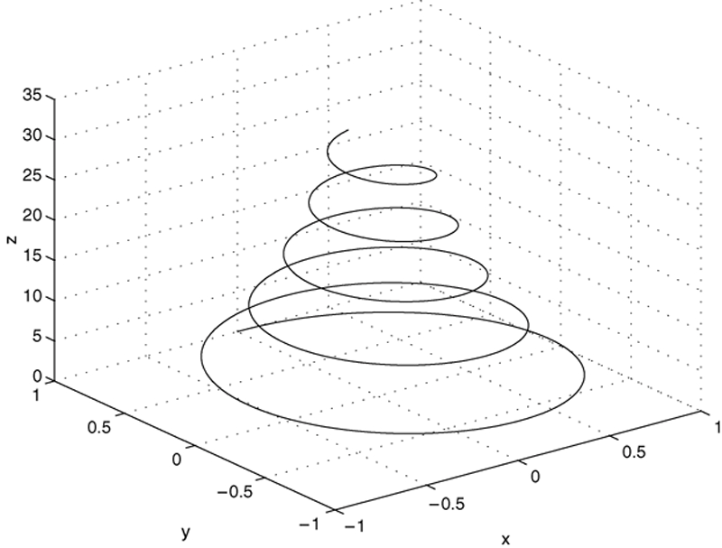
The curve x = e^{−0.05t} sin t, y = e^{−0.05t} cos t, z = t plotted with the plot3 function.

Slide 51
Surface Plots:
The following session shows how to generate the surface plot of the function z = xe^{−[(x−y2)2+y2]}, for −2 ≤ x ≤ 2 and −2 ≤ y ≤ 2, with a spacing of 0.1.
>>[X,Y] = meshgrid(-2:0.1:2);
>>Z = X.*exp(-((X-Y.^2).^2+Y.^2));
>>mesh(X,Y,Z),xlabel(’x’),ylabel(’y’),...
zlabel(’z’)

Slide 52
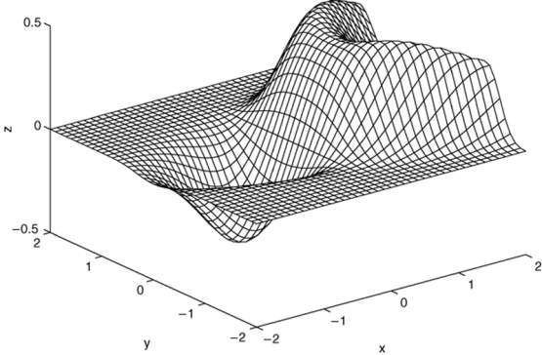
A plot of the surface z = xe^{−[(x−y2)2+y2]} created with the mesh function

Slide 53
The following session generates the contour plot of the function whose surface plot is shown in Figure 5.8–2; namely, z = xe^{−[(x−y2)2+y2]}, for −2 ≤ x ≤ 2 and −2 ≤ y ≤ 2, with a spacing of 0.1.
>>[X,Y] = meshgrid(-2:0.1:2);
>>Z = X.*exp(-((X- Y.^2).^2+Y.^2));
>>contour(X,Y,Z),xlabel(’x’),ylabel(’y’)

Slide 54
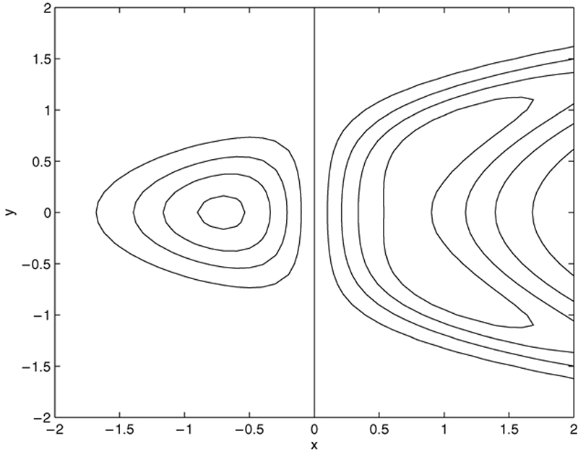
A contour plot of the surface z = xe^{−[(x−y2)2+y2]} created with the contour function.

Slide 55
Three-dimensional plotting functions..
Function
contour(x,y,z)
mesh(x,y,z)
meshc(x,y,z)
meshz(x,y,z)
surf(x,y,z)
surfc(x,y,z)
[X,Y] = meshgrid(x,y)
[X,Y] = meshgrid(x)
waterfall(x,y,z)
Description
Creates a contour plot.
Creates a 3D mesh surface plot.
Same as mesh but draws contours under the surface.
Same as mesh but draws vertical reference lines under the surface.
Creates a shaded 3D mesh surface plot.
Same as surf but draws contours under the surface.
Creates the matrices X and Y from the vectors x and y to define a rectangular grid.
Same as [X,Y]= meshgrid(x,x).
Same as mesh but draws mesh lines in one direction only.

Slide 56
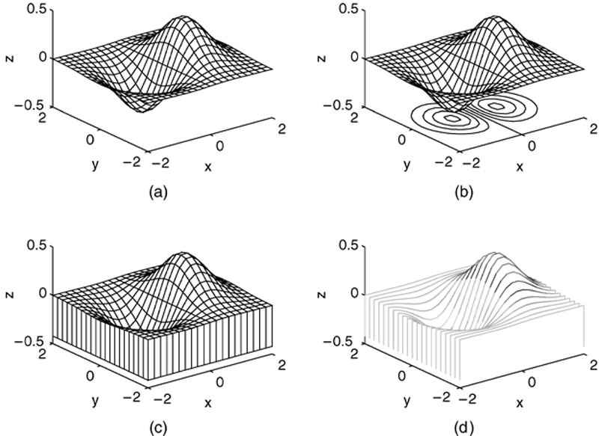
Plots of the surface z = xe^{−(x2+y2)} created with the mesh function and its variant forms: meshc, meshz, and waterfall. a) mesh, b) meshc, c) meshz, d) waterfall.

Slide 57
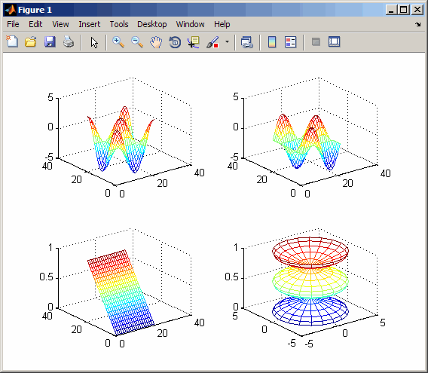
Displaying Multiple 3-D Plots in One Figure
subplot(m,n,p)
This splits the figure window into an m-by-n matrix of small subplots and selects the pth subplot for the current plot.
Example:
t = 0:pi/10:2*pi;
[X,Y,Z] = cylinder(4*cos(t));
subplot(2,2,1); mesh(X)
subplot(2,2,2); mesh(Y)
subplot(2,2,3); mesh(Z)
subplot(2,2,4); mesh(X,Y,Z)

